Slide 1
OOP decomposition
Cheat sheet

Slide 2
The basic steps
Figure out the nouns and adjectives
These become your classes and attributes
Figure out what needs what
These are your connections/links
Figure out the verbs or tasks (likely from scenarios)
These become your functions
Adverbs may become attributes needed by the tasks
Diagram for easy lookup
Scenarios can add more classes and attributes!

Slide 3
Heuristic for functions
Identify the task
Identify what data the task needs to complete the task
Identify who starts and who does the main handling of the task
Make sure all data is accessible to the handler
Make sure the task is reachable

Slide 4
rough modeling /whiteboarding
Rough example with everything
Class
-----------
Attributes
--------
function or description of functions
Class
-----------
Attributes
--------
function or description of functions
*...*
Class
-----------
Attributes
--------
function or description of functions

Slide 5
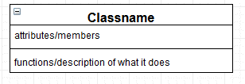
Notation: classes
This button is just a remnant from the software I used (draw.io)
Class name
This should match what you will eventually name the class
Attribute
Notation:
Name : Datatype
The data the class is working on. This includes state information
Mark arrays with []
Name : Datatype[]
Diagrams done with www.draw.io

Slide 6
Notation: classes
Functions
The major functions for the class
Alternatively, if you are early in the process, just a description of the class’s jobs/tasks
To state the return type:
Foo(name : Datatype, name: Datatype, …) : Datatype
Diagrams done with www.draw.io

Slide 7
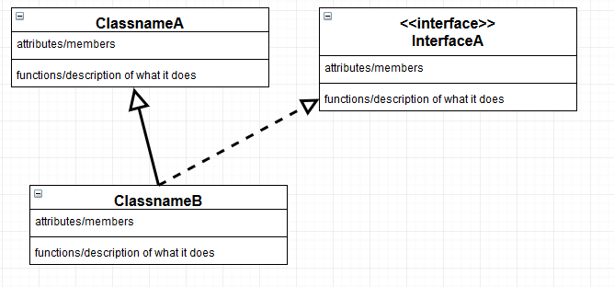
Notation: Functions
The first run of the diagram will normally be a description only
However…
If you KNOW you need it, add the function
If you KNOW you need it when working with other’s code (or people need yours), add the function
If you KNOW this will be needed for consistency, add the function

Slide 8
Notation: inheritance connections
Inheritance is shown with an arrow
Interfaces are tagged with <<interface>> or simply have the name in <<…>> (e.g. <<Animal>>). Ideally use a dashed arrow to show implementation (a solid arrow is OK)

Slide 9
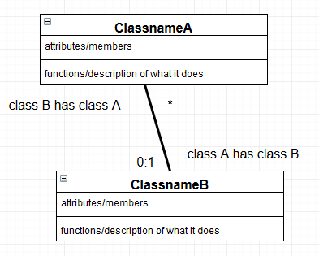
Notation: “has a” connections
A connection is shown with a line between two classes.
A connection has an optional “role” that describes the connection
The role of a class is on the far end of the line
Aside: True UML uses a large variety of different end caps

Slide 10
Notation: “has a” connections
A connection has a multiplicity (how many of a instances of a class that are owned).
1- just 1
0:1- 0 or 1
X:Y – X to Y instances
* - many
It is OK to have more than 1 connection between the same to classes
You MUST have a multiplicity or a very clear role. A role and multiplicity is better.

Slide 11
Notation: other info
Add additional notes if the diagram is not sufficient
E.g. private\public\protected is NOT mentioned
In UML these would be -, +, and # respectively
Abstract is also not mentioned and requires a note.
In UML it is italicized…but we can’t write italics by hand!
And more!
Make Abstract

Slide 12
Sequence Diagram
Refresher
ObjectA ObjectB Object C
Read Direction
function( params )
function() params
Currently on the stack
No Return Val
Return Val

Slide 13
Common errors
Having a collection member variable AND a connection
This says the code needs two collection member variable
Having a collection member variable and NO line connecting a class you defined in the problem
This says the code needs two different classes of the same name in a different namespace. One of which is defined elsewhere.
Using language specific syntax for collections
E.g. point : list<int> is incorrect
Using arrows AND multiplicities on connection
It means you have a derived class that also needs a member variable of its parent’s type, or vice versa.
There are times this is what you want, but convention adds another line.
Roles/multiplicities on wrong side or centered
Wrong side stops the code from reaching the class
Centered is ambiguous.
Ignoring the syntax rules for variables
Missing datatypes for variable (both in classes and functions)

